Slide 1
TMS Artifact Removal with Quasi-RNN
Andac Demir
August 15 2018

Slide 2
Reminder of the Problem
Learning the behavior of artifacts from a single channel and intensity
Methods we have tried in the past were based on one and bidirectional multilayer LSTM’s and Stochastic optimization methods

Slide 3
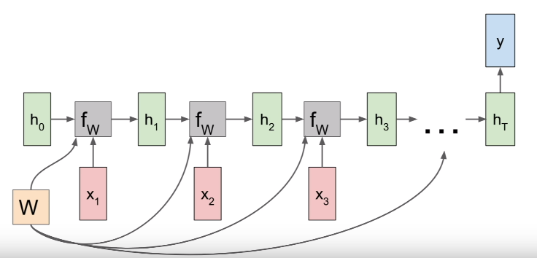
Reminder of the Problem
In this approach → we have a sliding window of size (less than 20)
We take the samples in the window as input and train the network to predict the next sample in the sequence

Slide 4
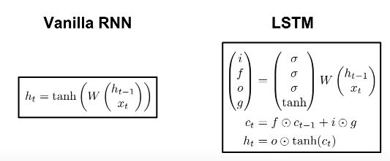
x is the input at time step t
y is the sample predicted right after the sliding window
We apply a weight matrix on all the inputs and hidden states from the previous cells
In Vanilla RNN → f_{w} is tanh
In LSTM → the cell state is updated by the gates called (input gate, forget gate, output gate, gate gate) and then that is used to update the hidden state.

Slide 5
Gate Information
The main advantage of LSTM’s to RNN’s is in RNN’s you do the same matrix multiplication over and over and that increases the chances of exploding and vanishing gradients problem.
However, in LSTM’s you do elementwise multiplication with the forget gate, input gate, output gate and gate gate of each cell. And all these gates are different, therefore you don’t have vanishing or exploding gradient problems.

Slide 6
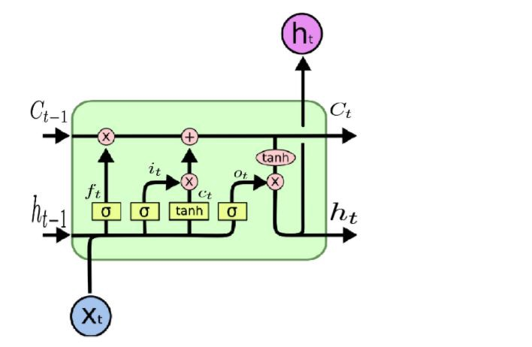
Gate Information
If forget gate=0, you forget the cell state from the previous cell. Or if f is close to 1, you take more information from the cell state of the previous cell.
Element-wise product of input gate and gate gate decides whether / how much to write to the cell state at that time-step.

Slide 7
Reminder of the Data
Dataset: TMS-EEG
Sampling rate: 5kHz
Intensity range (MSO): 10-80
Channels: 0-62 (63 channels)
Stimulus start: 10000th sample
Num. of trials: 30
Truncated to cover only 9990th-10040th samples (sequence length:50)

Slide 8
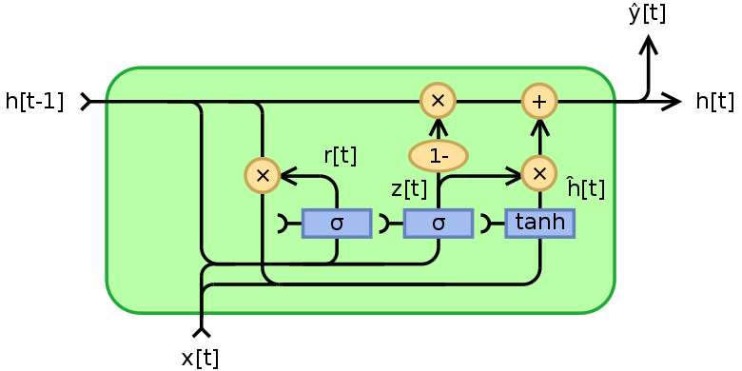
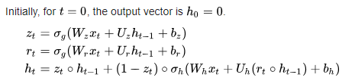
Update in the Network
Gated Recurrent Unit implemented as an alternative to LSTM
Variables
x: input at time step t
h: hidden state
z: update gate vector
r: reset gate vector
W, U, and b: parameter matrices and vector
Activation Functions
σ_{g}: Sigmoid function
σ_{h}: Hyperbolic function

Slide 9
LSTM vs GRU
GRU has two gates (reset and update) whereas an LSTM has four gates (input, output, forget and gate gates)
GRU unit controls the flow of information like the LSTM unit, but without having to use a memory unit.
It exposes the full hidden content (exposure of the complete memory) unlike LSTM (exposure of the limited memory).
Performance better than LSTM’s in smaller dataset.
Training faster

Slide 10
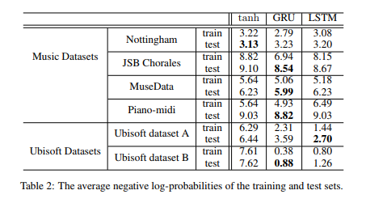
Performance Comparison
In “Empirical Evaluation of Gated Recurrent Neural Networks on Sequence Modeling”, GRU’s and LSTM’s are compared on the tasks of polyphonic music modeling and speech signal modeling.
Paper Link: https://arxiv.org/pdf/1412.3555v1.pdf

Slide 11
Update in Network
RNN not bidirectional in this architecture
There are two stacks of RNN’s (LSTM and GRU, chosen by the user via entering it as an argument on the terminal)
Each stack of LSTM and GRU have 64 hidden units
Hidden states of the last stack are fed into a fully connected layer of 64 neurons, which does high level reasoning in the network.

Slide 12
Update in the Optimization
Previously used Stochastic based optimization methods (Adam, SGD)
Now using a Limited-BFGS, a Quasi-Newton optimization technique.
Faster convergence, much lower loss, numerically more stable but higher usage of memory
Well suited for small datasets where you can load all data for training.

Slide 13
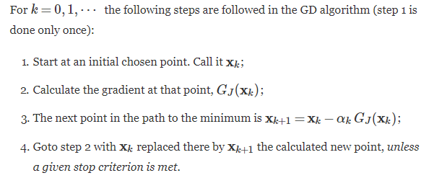
Gradient Descent
Gradient of the function J:

Slide 14

SGD, Adam
SGD is the same as GD with the replacement of the batch gradient by the stochastic gradient.
Adam’s difference from SGD is it updates the gradients used in iteration with a technique called momenta.
In SGD, update method is:
In Adam, update method is:

Slide 15

Update in the Optimization
L-BFGS estimates the inverse of the Hessian matrix to steer its search through the variable space.
BFGS method does not estimate. It stores the dense nxn approximation of the inverse Hessian. So number of variables is a problem in this case.

Slide 16
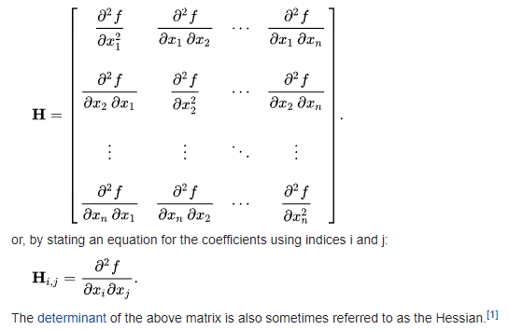
Hessian Matrix
If all second partial derivatives of f exist and are continuous over the domain of the function, then the Hessian matrix H of f is a square n×n matrix, usually defined and arranged as follows

Slide 17
Update in the Implementation
All code re-written.
For the deep learning framework, switched from Keras to PyTorch
Keras provides a lot of abstraction, but PyTorch allows flexibility
Keras is a higher-level framework wrapping commonly used deep learning layers and operations and abstracting the deep learning complexities
PyTorch offers a comparatively lower-level environment for experimentation, giving the user more freedom to write custom layers and look under the hood of numerical optimization tasks

Slide 18
Training – Validation - Test
No cross validation applied
22 trials used as training set:
adjusting the weights and hidden units of the network
5 trials used as validation set:
weights not adjusted, parameters not tuned, loss function tracked to validate the network does not overfit
3 trials used as test set
used for testing the final model in order to confirm the actual predictive power of the network

Slide 19
Results
Results from arbitrarily picked channels & MSO intensity levels

Slide 20
Future
Not much
We can transfer the learning from one intensity / channel (?) to all the others.
Fitting a Gaussian Mixture Modeling over the hidden states of the GRU can help us understand the semantics of our NN model.
We can find a mapping or train another NN that translates the means and variances of one intensity to the other, and then for the new RNN model, we can sample the hidden units from those Gaussian. (I need to think more about it….)
Non-linear scaling of the data instead of minmax (0-1)!

